Slide 1

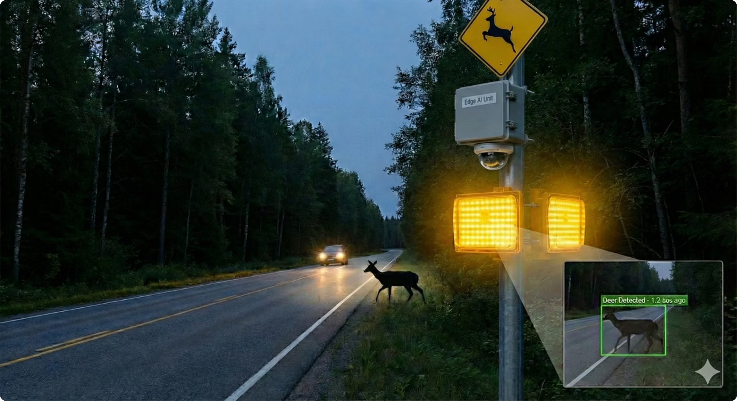
Edge-AI Wildlife Detection & Roadside Warning System
Enhancing Road Safety with Real-Time Computer Vision

Slide 2
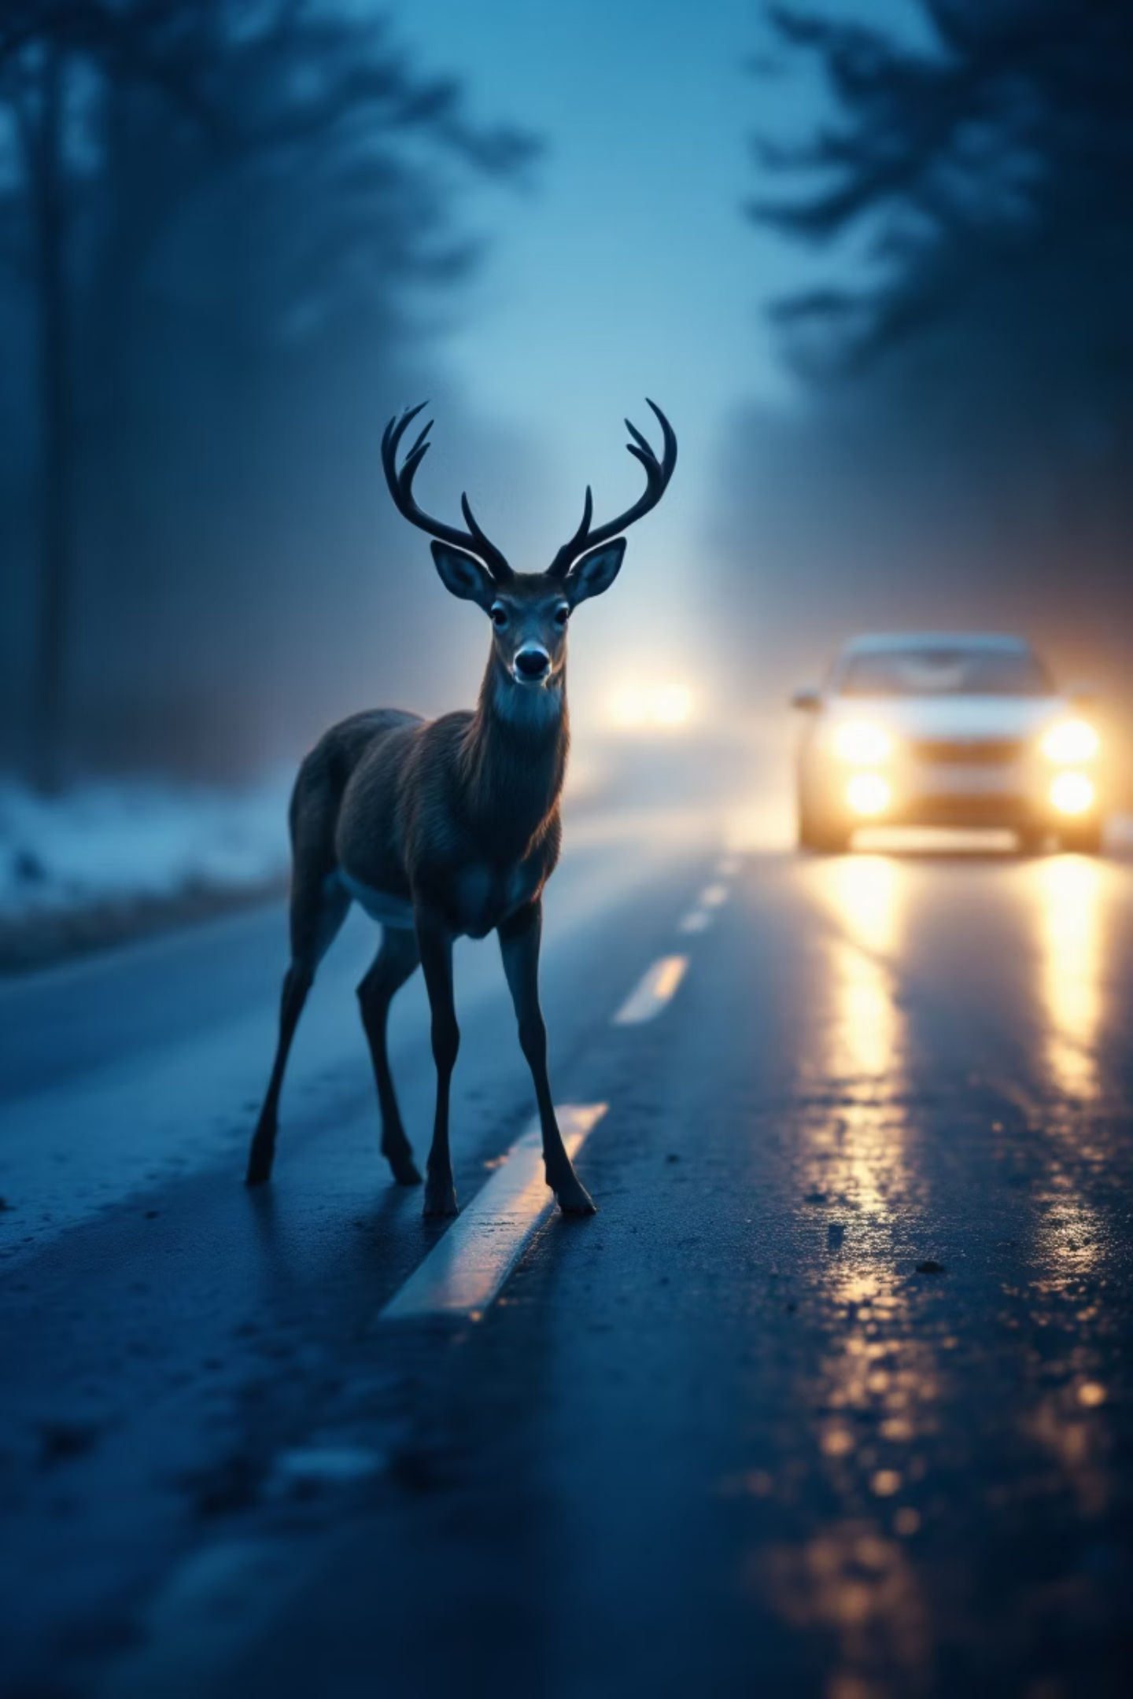
The Problem: A Silent Threat on Our Roads
Wildlife-vehicle collisions are a major safety and conservation issue.
Static signs are often ignored by drivers.
Existing detection systems are expensive or slow.
The Need: An affordable, real-time, and autonomous warning system.

Slide 3
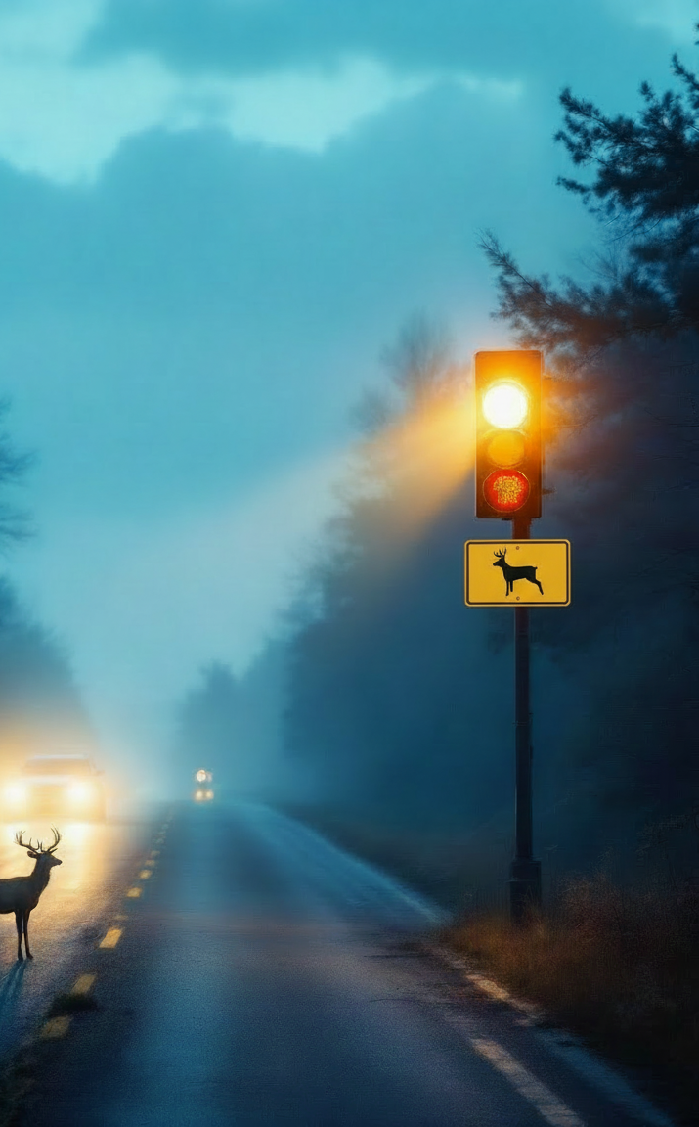



The Solution: Smart Edge AI for Safer Roads
Concept: A smart edge device that 'sees' wildlife and warns drivers instantly.
Core Function: Detects animals -> Triggers Flashing Beacon -> Logs Data.
Value Proposition: Low latency, privacy-preserving, and cost-effective.

Slide 4

Classical ML Approach
Explored using Random Forest, SVM for detecting images with wildlife.
Due to limitations, we opted for CNN (YOLO).
Image Classification vs Object Detection.
Random Forest for Dataset image classification (day/night)

Slide 5
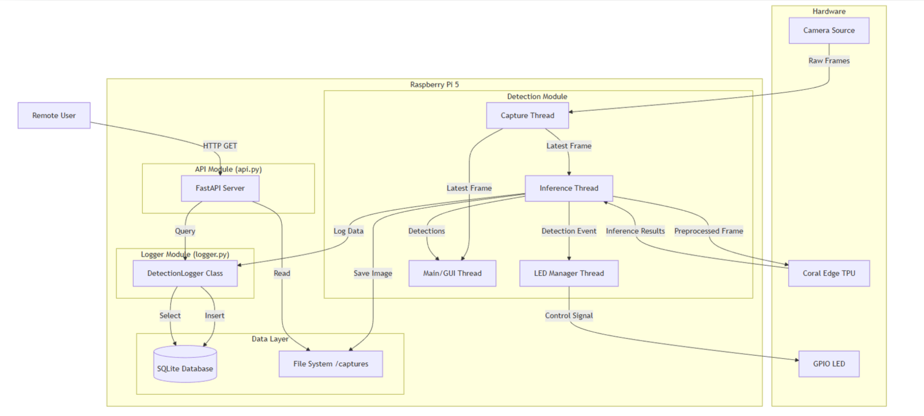
System Architecture
Input: Camera captures video.
Processing: Raspberry Pi 5 + Coral Edge TPU runs custom AI.
Action: Triggers LED Beacon immediately upon detection.
Data: Logs event to DB & exposes via API.

Slide 6





Under the Hood: Our Robust Technology Stack
High-Performance Hardware
AI Acceleration
Raspberry Pi 5 for rapid processing power.
Coral Edge TPU for efficient, real-time AI inferences.
Custom AI Model
Why Edge AI?
YOLO model trained specifically for local wildlife (Deer, Moose) in Google Colab.
No internet needed for detection = Instant reaction time.

Slide 7

Training the YOLO Object Detection Model
Create a dataset from scratch and label using labelstudio
Leverage pre-trained Yolov11n.pt Pytorch weights
Modify key hyperparameters (epochs and imgsz) to optimize the resulting model.

Slide 8
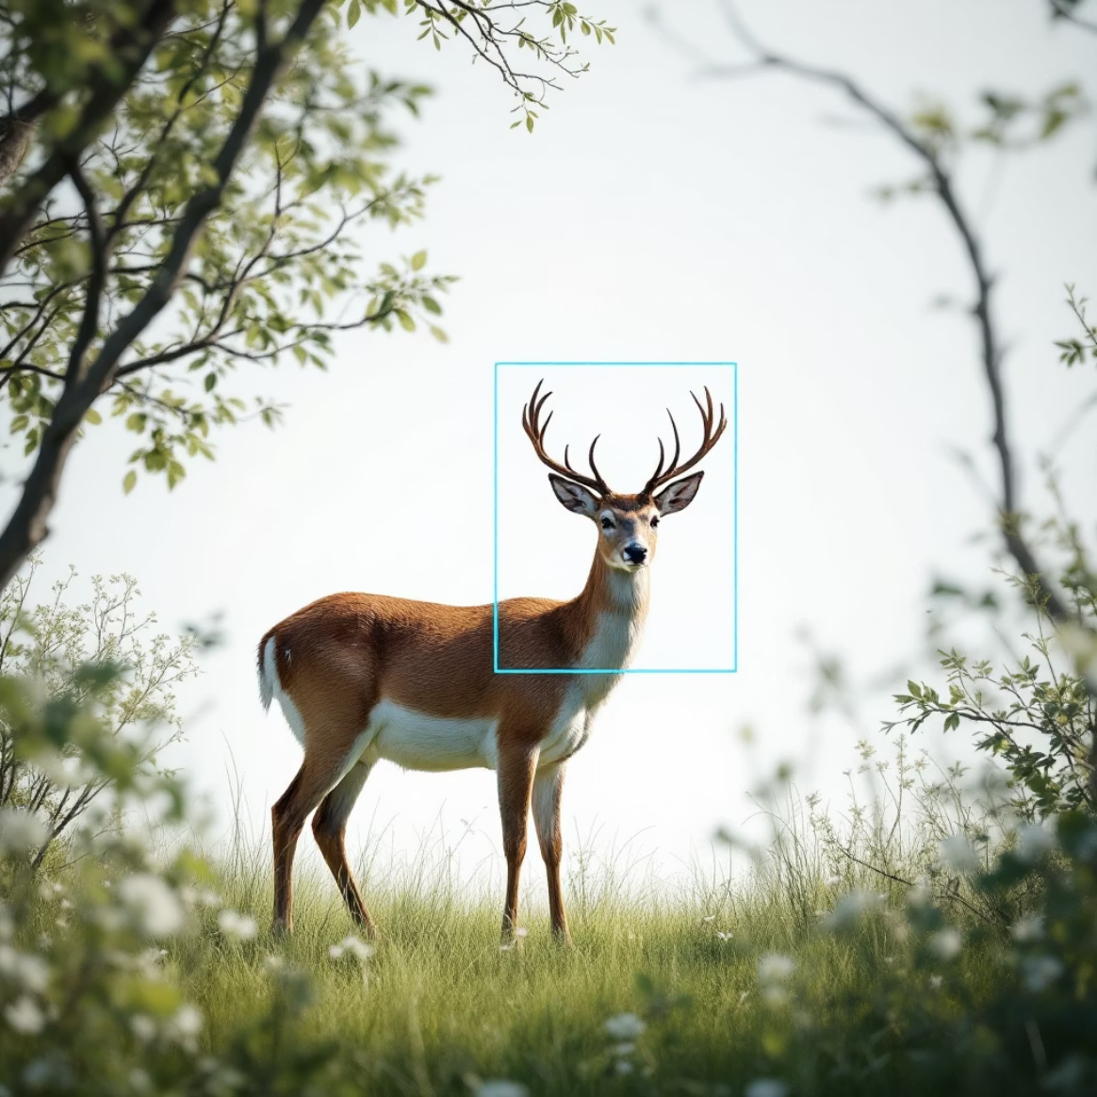

Live Demo: Experience the Prototype
Real-Time Visual Feedback
Instant Hardware Response
Bounding boxes pinpoint wildlife directly on the live video feed.
The LED beacon activates immediately upon detection, providing critical warnings.
API access available for remote data monitoring and integration.

Slide 9






Impact & Scalability
Valuable Data Insights
Assists conservationists in tracking animal crossing patterns and habitats.
Enhanced Road Safety
Dynamic warnings drastically reduce wildlife-vehicle collisions.
Cost-Effective Deployment
Low unit cost enables widespread implementation across high-risk areas.

Slide 10



Future Roadmap: Evolving for Tomorrow
Short Term
Long Term
Night mode implementation for 24/7 detection.
Integration with smart city infrastructure (V2X).
Development of a comprehensive web dashboard.
Broader wildlife species detection capabilities.
1
2
3
Medium Term
Cloud synchronization for centralized data management.
Advanced analytics for predictive modeling.

Slide 11

Conclusion: A Safer, Smarter Future
Working Prototype
Tangible solution addressing a critical real-world problem with Edge AI.
Call to Action
Join us in making our roads safer and smarter for everyone.
Let's make our roads safer and smarter.
We welcome your questions and insights.

